Slide 1

Usability Testing Suite With Facial Expression Recognition
Damian Wojtowicz
C17413722
DT228
Supervisor: Andrea Curley

Slide 2

SUMMARY OF CONTENTS
Main Topics
Project Idea
Background
Methodologies
Technologies
Design
System Architecture
FER Model Architecture
Front-End
Middle-Tier
Database
Demo
Test & Evaluation
Future Work
2

Slide 3

PROJECT AIMS
The aim of the project is to provide a usability testing suite that can be used to test the usability of software and to investigate the use and applicability of facial expression recognition (FER) technology in usability testing.
WHAT IS THE PROJECT ABOUT?
3

Slide 4
BACKGROUND
Landowska (2015) investigated the use of emotion analysis for usability testing.
Their research included various means of obtaining the emotion data, one of which was facial expression recognition.
EXISTING RESEARCH
4

Slide 5
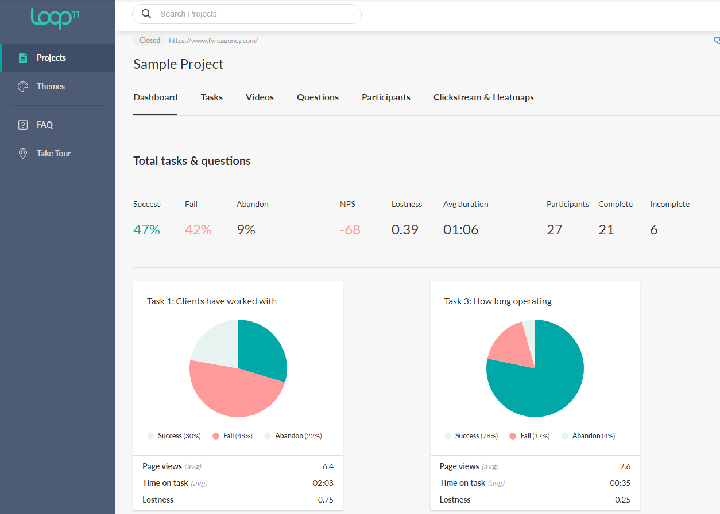
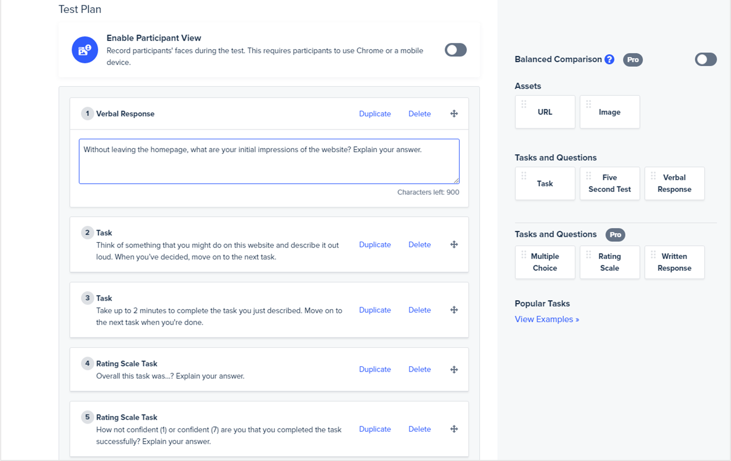
BACKGROUND
EXISTING APPLICATIONS
4

Slide 6
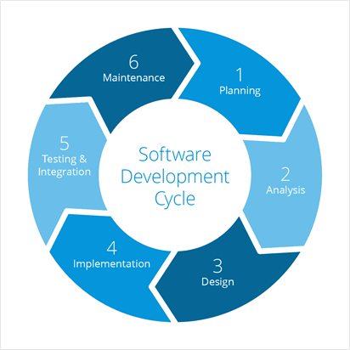
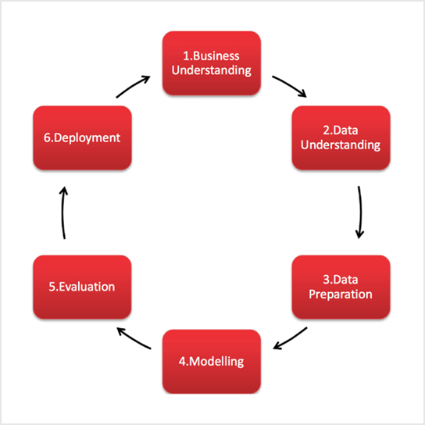
METHODOLOGIES
Scrum Agile
CRISP-DM
5

Slide 7
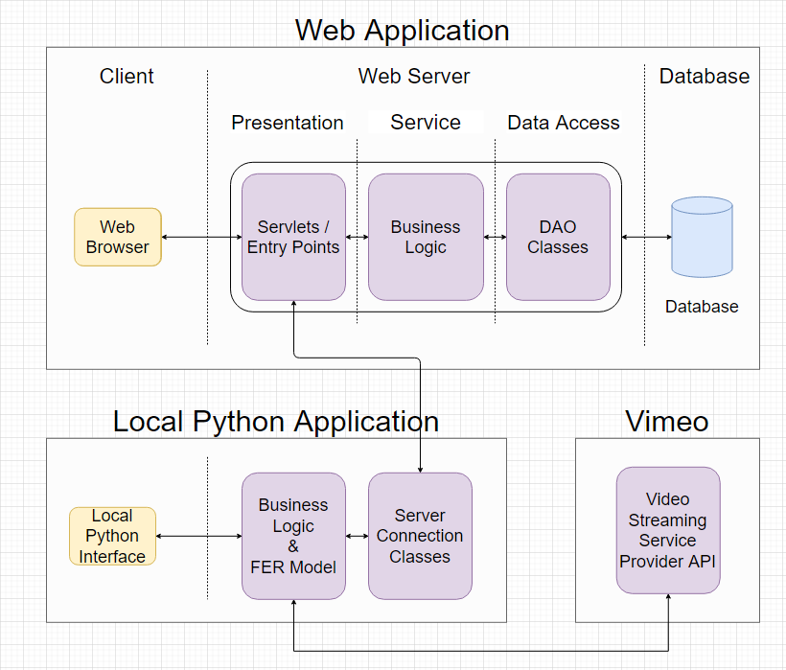
SYSTEM ARCHITECTURE
7
Pixelast | Design and Tech

Slide 8
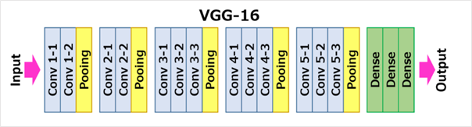
FER MODEL ARCHITECUTRE
The model chosen is the VGG-16 model
It is an award winning Convolutional Neural Network (CNN) in 2014
It consists of 5 blocks
Each block starts with convolutional layers followed by a pooling layer
8

Slide 9
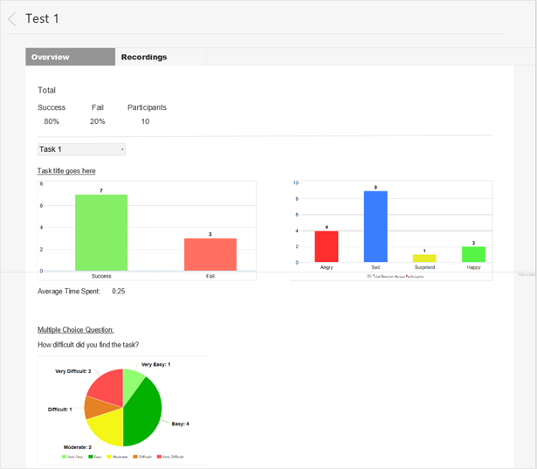
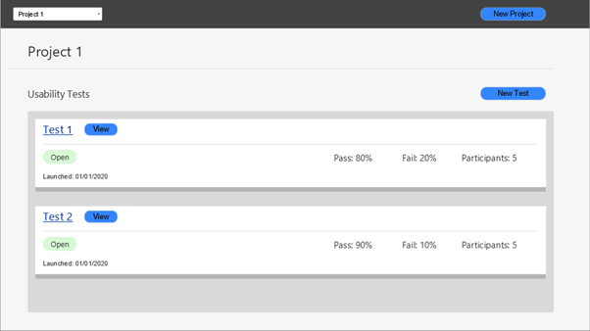
FRONT-END
WEB APPLICATION
PROTOTYPES
9

Slide 10
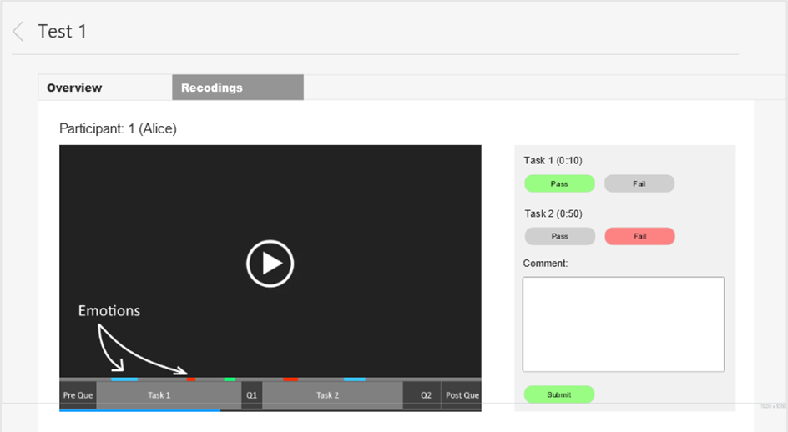
FRONT-END
WEB APPLICATION
PROTOTYPE
10

Slide 11
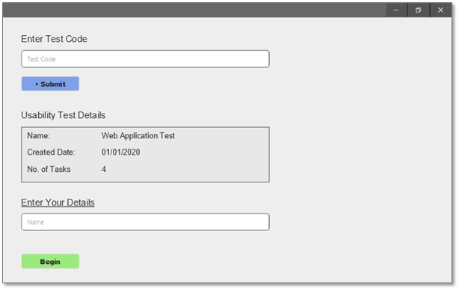
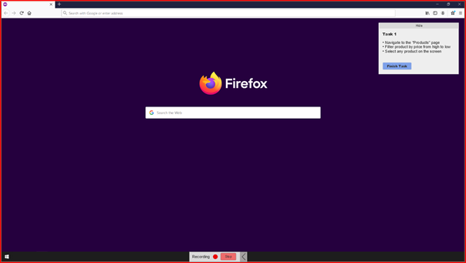
LOCAL PYTHON APPLICATION PROTOTYPE
11

Slide 12
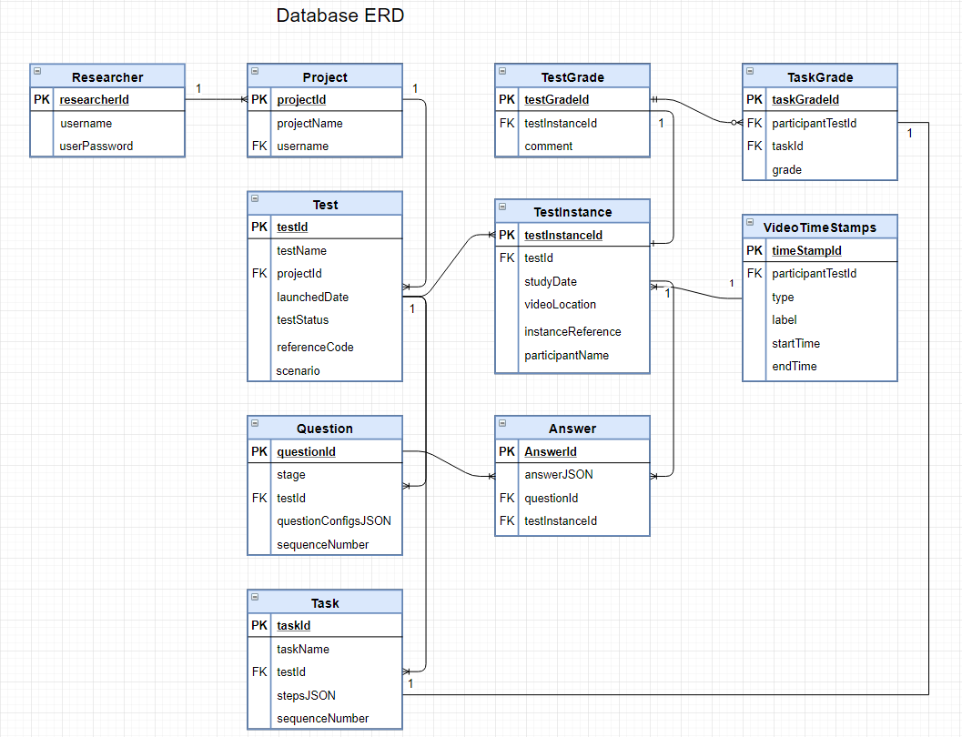
DATABASE
ENTITY RELATIONSHIP
DIAGRAM
(PRODUCTION)
12
13

Slide 13
Operating Systems
Windows 10
Programming Languages
Java
JavaScript
Python
Databases
MySQL
Frameworks & Libraries
Spring
React
JDBC
TensorFlow
Keras API
PyQt5
Tools
GitHub
Anaconda & Jupyter
VS Code
Eclipse IDE
MySQL Workbench
Other
Vimeo
Heroku
DEVELOPMENT
TECHNOLOGIES
CHOSEN
6
Pixelast | Design and Tech

Slide 14
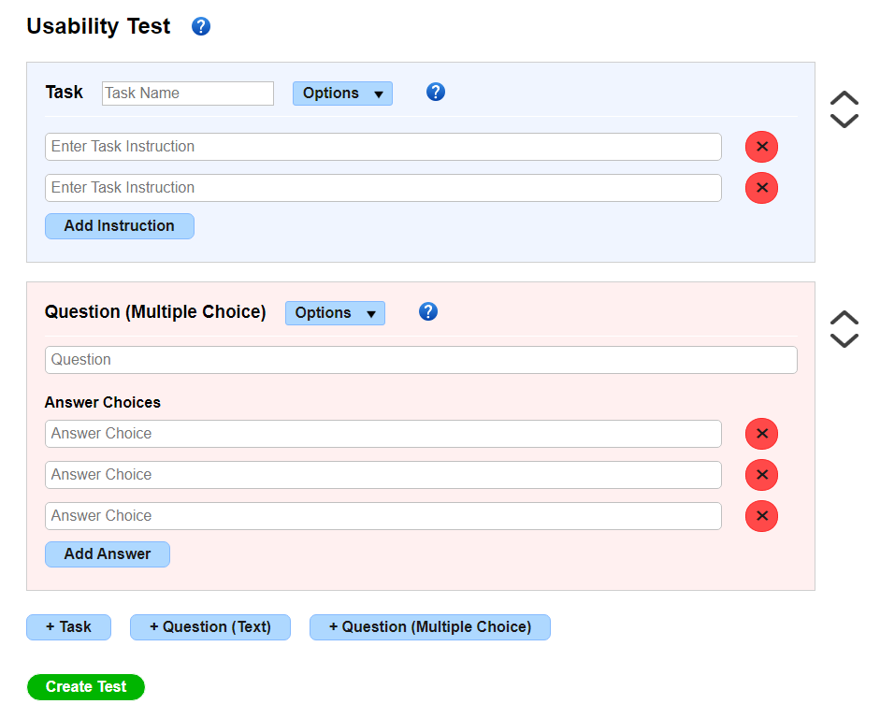
DEVELOPMENT
REACT
Being New
Render/Re-rendering
Dynamic Components
Charting Library
9

Slide 15
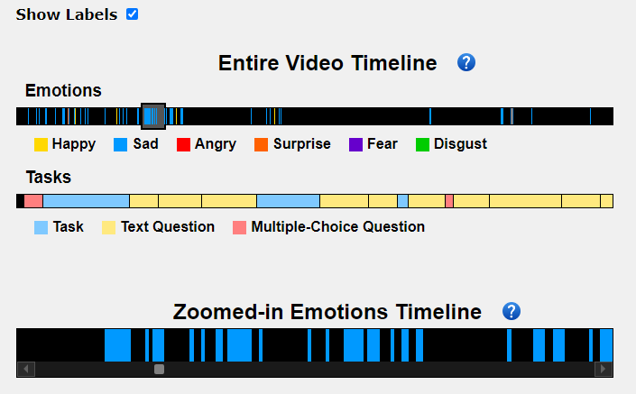
DEVELOPMENT
VIDEO TIMELINES
Broken Libraries
Scaling
Vimeo API (Interactive)
Great End Result
Video Embedding (Cross-site policies)
9

Slide 16
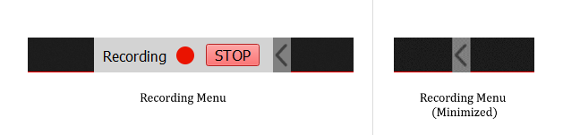
DEVELOPMENT
SCREEN RECORDING
Frame Sync
Multiple Screens
Mouse Cursor
9

Slide 17
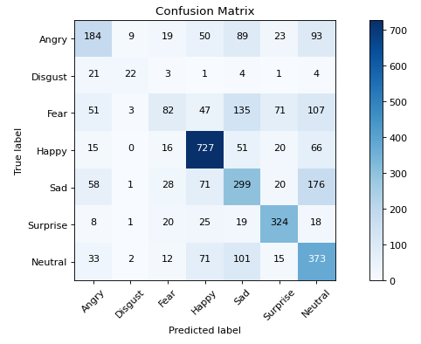
DEVELOPMENT
MACHINE LEARNING
Anaconda
Installing Libraries
Configuring GPU
Confusion Matrix
Data Loaders
9

Slide 18
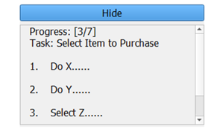
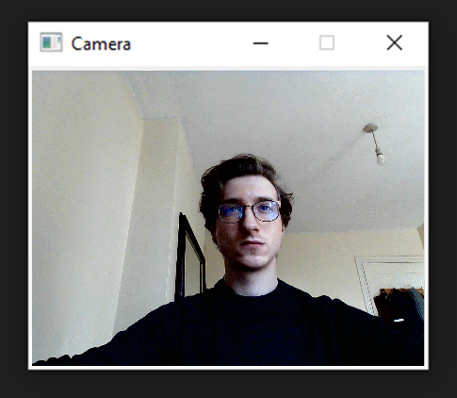
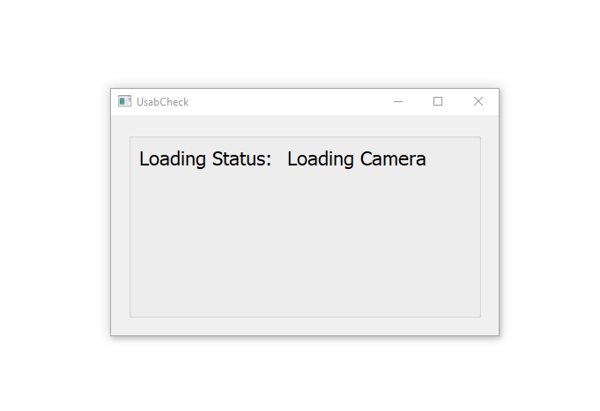
DEVELOPMENT
LOCAL APPLICATION
New to UI Dev in Python & PyQt5
Concurrency/Multi-threading
Component Loading
Removing Title Bar
Integrating FER Model
9

Slide 19


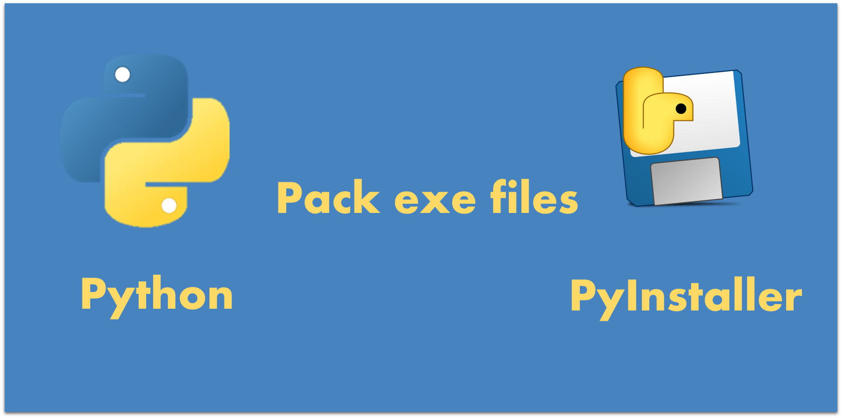
DEVELOPMENT
DEPLOYMENT
Automated Deployment Plugins
Heroku Build Packs
Deploying to Directory
9

Slide 20
DEMO
THE WEB APPLICATION & LOCAL APPLICATION WILL BE PRESENTED
VIDEO LINK:
https://youtu.be/Y92833q55mw
14

Slide 21
Facial Expression Recognition Model
The accuracy of the model was compared with the state-of-the-art results (VGG model achieved a 72.7% Accuracy on FER2013 Dataset).
The better model in this project which is a variation of the VGG-16 Model achieved an accuracy of 57.7%
Metrics such as precision, recall, accuracy and f-score were looked at.
Model was tested on 2 other datasets and results were compared. Comparison data displayed with confusion matrices and bar charts.
Occlusion of face and specific facial features and camera angles.
Participants were asked to make face expressions in front of the camera and the performance was recorded.
Integration testing to verify that the timestamps and predictions are synchronized with the video.
TESTING & EVALUATION
15
Pixelast | Design and Tech

Slide 22
Web App & Local Application
Black-box system testing was conducted to ensure the integrated components and the system was working.
While developing white-box and grey-box testing were conducted to ensure that the code was robust and working.
When applicable modules were tested on their own before being integrated into the system.
Automated unit testing was performed on the local application
Both applications were evaluated by an expert and Nielsen’s heuristics
Separate usability studies were conducted to test both applications (acceptance testing)
Impaired vision simulator was used on web app
TESTING &
EVALUATION
15
Pixelast | Design and Tech

Slide 23
December
Train the FER model on the other datasets (JAFFE, FacesDB)
Fix the displaying of metrics for the first model
Setup the database and a basic front-end and middle-tier of web app
January
Implement the login functionality
Create the local Python application
Integrate FER model into python application and conduct a basic usability test
February
Implement video uploading
Display the data in the web application
Add additional features to make the system complete
March
Integration of components
Testing, Evaluation & Dissertation report
FUTURE WORK
16

Slide 24
Thank you for listening!
Please feel free to ask any questions

